Slide 1
ISTFA
A/V Guide for a Podium Presentation
Sample Title Slide
Company
Logo
Company Logo allowed on title slide ONLY (optional)
Im N. Engineer
Sandy Nation Labs
Desert, NM USA
Authors and affiliations

Slide 2
Outline
Sample Outline Slide (required)
Introduction
Page Layout
Slide/Text Formatting
  Good example
  Bad example
Preparing Figures
Animation/Video
Presentation Review Processes
Exceptions/Revisions
Conclusions
Appendices
  Ideas for reducing the file size
  Using the “Presenter View”
Notes:
3

Slide 3
Introduction / Background / Purpose / Objective
Sample Introduction Slide (Required)
Review the standards first for preparing presentation slides for ISTFA
Use the sample PowerPoint file as a template for creating your presentation
Use Bold Dark text on bright background. Minimum font size is 20pt. Arial, Helvetica and Symbol US default fonts RECOMMENDED. Use of other fonts at your own risk. If the text it is not legible, ISTFA A/V Chair can reject/modify the presentation.
Page numbers in lower right corner
Starting on page 2

Slide 4
Introduction (cont’d):
Electronic Presentation at ISTFA
Software to use:
  Microsoft PowerPoint version 2013 and earlier
  Motion effects or transitions can be used for clearly showing data only
    Do not use transitions gratuitously
    Can be distracting to the audience
  The AV committee determines if motion effects and transitions are excessive
Minimum font size is 20pt.

Slide 5
Page Layout
File → Page Setup:
  Slides sized for On-screen Show
  Landscape mode
  Aspect ratio 16:9
Maximum of 20 slides
  Unless authorized by session chair
Page number at lower right
Four required slides:
  Title, Outline, Introduction/Background, Conclusions
No slide transitions or “custom animation" (motion effects)
  Unless clearly beneficial to technical communication, e.g. figure overlays
Page numbers in lower right corner

Slide 6
Slide/Text Formatting
Arial, Helvetica or Symbol fonts are easy to read
  Math and Greek symbols are found in the Symbol font
Bold font, minimum of 20pt for all body texts
  For figure captions, legends, axis labels etc., minimum size of 18pt is acceptable if space is limited
Black or high-contrast color text on white (clear) background, or white/high-contrast text on dark background
  Use color text carefully (View next 2 slides in viewer mode for examples)

Slide 7
Example – Good Slide Formatting
(high contrast text & background combination)
Text is written in Arial, Helvetica or Symbol fonts
Θ = 90º
λ = 1064 nm
Bold font, minimum of 20pt for all body texts
  For figure captions, legends, axis labels etc., minimum size of 18pt is acceptable if space is limited
Black or high-contrast color text on white/light background or white/light text on dark background
  Use color text carefully
(Good imported graph, line width and
font size are visible)

Slide 8
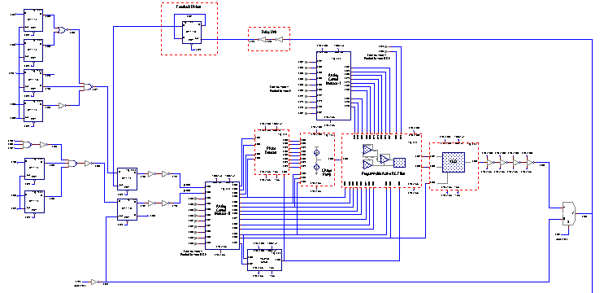
Example – Bad Slide Formatting
(low contrast text & background combination)
Small font size is hard to read across a crowded room
  No bold makes lines thin and difficult to read (not everyone in the audience wears glasses)
Note
Bullet
Transitions
Can
Be
Distracting
(Poor imported schematic, line width and
font size not visible, text is to small)
This slide has too much information and too many colors on it making it difficult to read causing the audience to focus on what you have written on your slide versus what you are communicating. The audience would like to hear what you have to say instead of struggling to read it on your slide. A slide with this much information and/or bullets on it should be broken into 2 slides and made easier to read and convey data for the audience. The above schematic would be better broken into 2 pieces to demonstrate the key points of the layout. Bullet transitions if technically relevant should not be distracting. Color blind people can not distinguish between red & green.

Slide 9
Preparing Figures
Imported curves must be thick and clear
Imported text must conform to text guidelines
The lines should be at least 3 point

Slide 10
Preparing Figures
Imported images must be clearly labeled
2
1
AC
INV. to
Stress
4
Current
Controlled
Oscillator
(ICO)
2
NMOS
Stress
3
3
1
4
Heater
Temp.
Sense

Slide 11
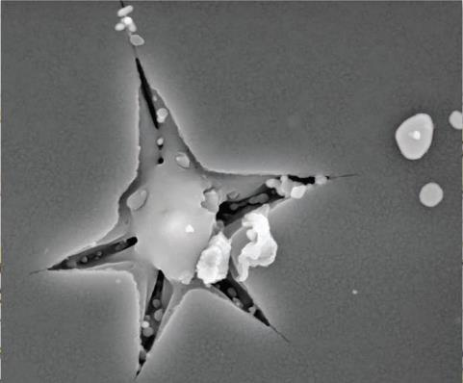
Preparing Figures
Figures must be large and easy to read
Figures must take up at least 25% of the slide
Labeling within a figure must comply with presentation font guidelines (18 pt minimum)
An example of a properly sized figure

Slide 12

Preparing Figures
Text in figures must be considered carefully
The example at the right is illegible
The figure itself is too small and of little value to audience members
An example of a poorly sized figure, if you expect the audience to read
data in the figure

Slide 13
Animation/Video
Animation/Video can be used for clearly conveying technical information
  Animation and Video will be approved by the A/V chair based on the importance for conveying technical content
Animation/Video used must be compatible with PowerPoint
  Cannot exit presentation to play animation/video
    Embedding the video files into a presentation is preferred
    If it is not possible to embed the video files in the presentation, the video file should send with the presentation for easy linking
    .mpg or .avi format only

Slide 14
Presentation Review Processes
Presentation slides will go through two steps of review in Confex
The first review will be done by assigned mentor(s)/session chair/co-chair. This review will focus on technical contents and A/V formats too
If revision required, mentors will send the presentations to the bucket of Revisions Required
If technical content is approved, session chair/co-chair will send the presentation to the bucket of A/V Review only

Slide 15
Presentation Review Processes
Then A/V chairs will review the A/V formats of the presentation again
If A/V formats are not satisfactory, A/V chairs will send the presentation to the bucket of A/V format change required
Authors make A/V format changes accordingly and send the presentation to the bucket of A/V format change Uploads
A/V chairs review the presentations in the bucket of A/V format change Uploads again and send to final approved if satisfactory

Slide 16
Exceptions/Revisions
Exceptions to the A/V Standards must be approved by the A/V Chair IN ADVANCE
  The standards are meant to ensure high quality presentations that can be seen by everyone attending, not restrict technical expression
  Send questions to your paper mentor, session chair or the A/V chair
NO CORRECTIONS to the presentation files will be allowed after the presentation has been accepted
NO CORRECTIONS to the presentation files are possible at ISTFA

Slide 17
Conclusions
Sample Conclusions Slide (required)
When preparing your ISTFA PowerPoint presentation, follow the A/V Standards from the start
Remember: Corrections to the slides will NOT be possible at the Symposium
Ask questions early in the process to avoid complications. Contact your session chairs for questions
We are here to help you make a great presentation. Thank you for your participation and see you at ISTFA 2021

Slide 18
Appendices

Slide 19
Reducing the File Size of your Presentation
Smaller file size helps in faster upload and download
MS PowerPoint has options to help you
  Delete picture editing data
  Compress figures
There are general options entries
  Not recommended
The options also become accessible when you save the presentation

Slide 20
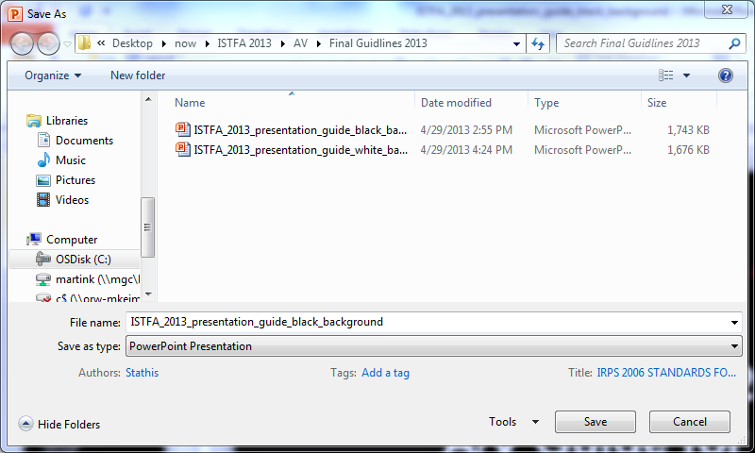
  Reducing the File Size
In the ‘File’ Menu, select ‘Save As’
Pull down ‘Tools’ (1), then select ‘Compress Pictures’
Select 150dpi or 96dpi.
Double check that the presentation quality is still acceptable to you
(1)

Slide 21
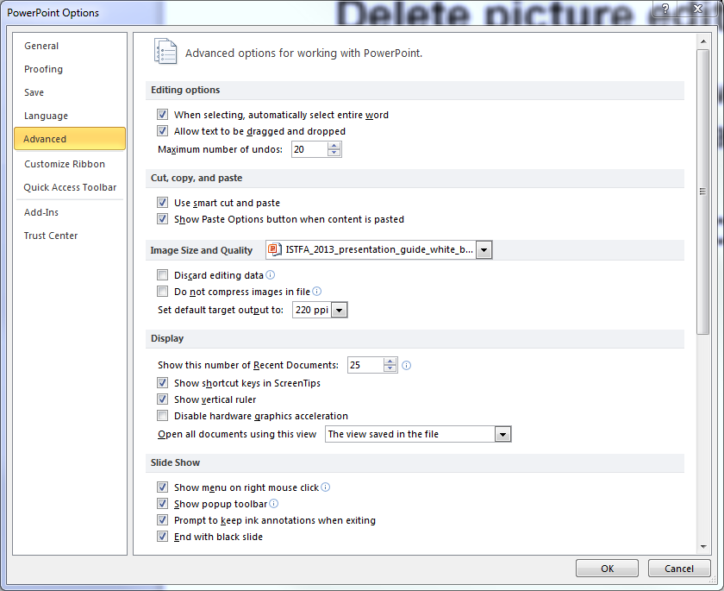
  Reducing the File Size (cont.)
In the ‘Tools’ pull down from the previous slide, use ‘Save Options’, then select the ‘Advanced’ option
Find the ‘Image Size and Quality’ section
Select “Discard
editing data”

Slide 22
Using the Presenter View
“Presenter View” is a feature of MS PowerPoint
It allows 2 different views of the same slide set
  One for the presenter
  One for the audience
Note: All subsequent explanations and screen shots are using PowerPoint Version 2010

Slide 23
Using the Presenter View
Among other data, the presenter can
  see all slide notes
  see the several of the upcoming slides
  see the time
  easily go forward and backward to any chosen slide
More details at Microsoft:
http://office.microsoft.com/en-us/powerpoint-help/what-is-presenter-view-HA010360603.aspx

Slide 24
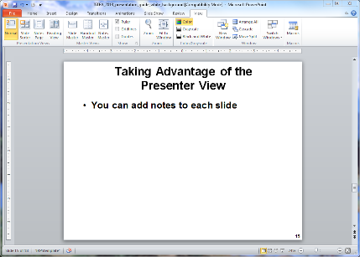
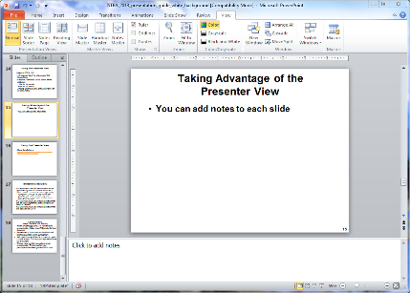
Taking Advantage of the
Presenter View
First, gain access to the notes panel
In case your window looks like the left one, click on View (1), then Normal (2)
Your window should now look like the one on the right
(2)
(1)
Notes:
Explain how to get to the notes pane in MS PowerPoint
Usually it is available by default.
However, the user might have clicked it away.
To get it back, it is an easy 2 step process
1 : Click on the ‘View’ Menu entry
Then
2: Click on the ‘Normal’ picture

Slide 25
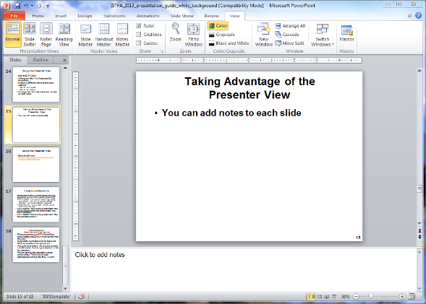
Taking Advantage of the
Presenter View
Then add notes to each slide
Add notes
here

Slide 26
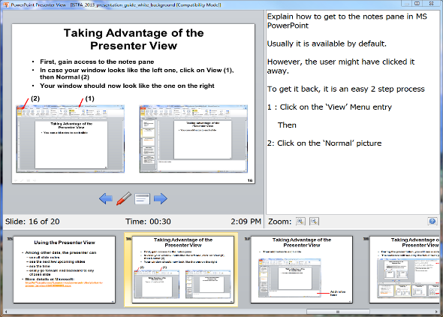
Using the Presenter View
During the presentation you will see a screen like this one
The audience is still seeing only the full-screen slide
Notes show
up here
Time & Status
Information
Next slides

Slide 27
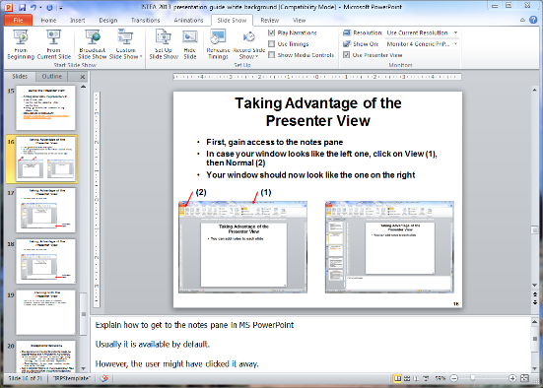
Training with the Presenter View
To use the presenter view, you need 2 monitors
To activate, click the Slide Show menu (1)
Make selections in the ‘Monitors’ section (2)
Then start the presentation as normal (3)
(3)
(1)
(2)

